Slide 1




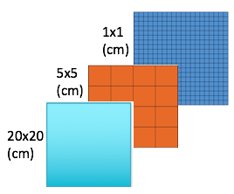
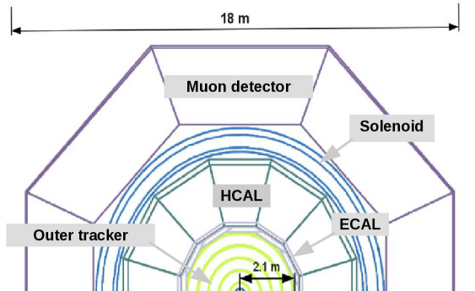
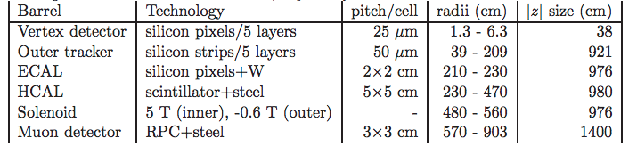
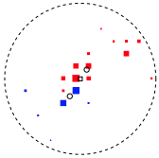
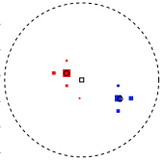

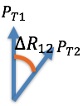
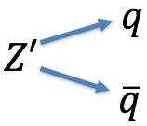
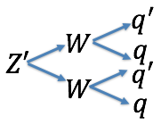
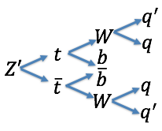
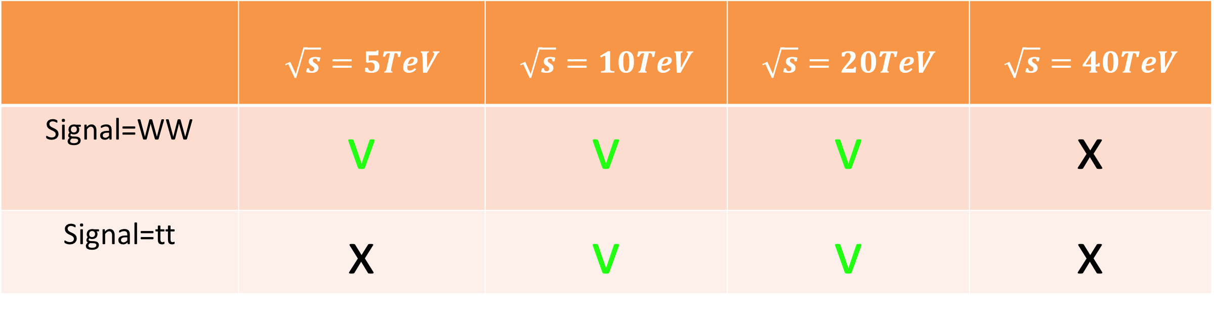

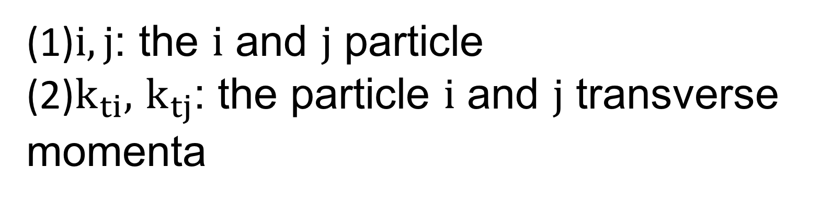
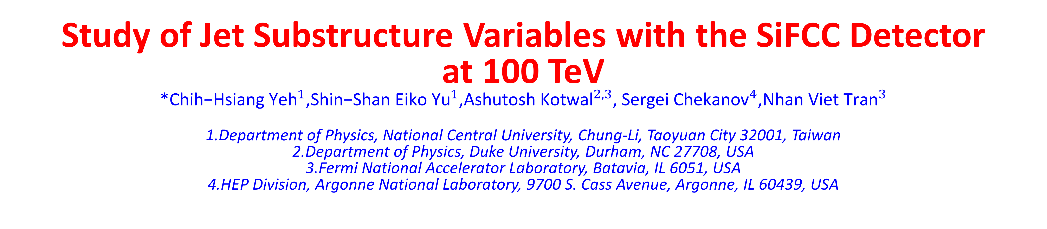


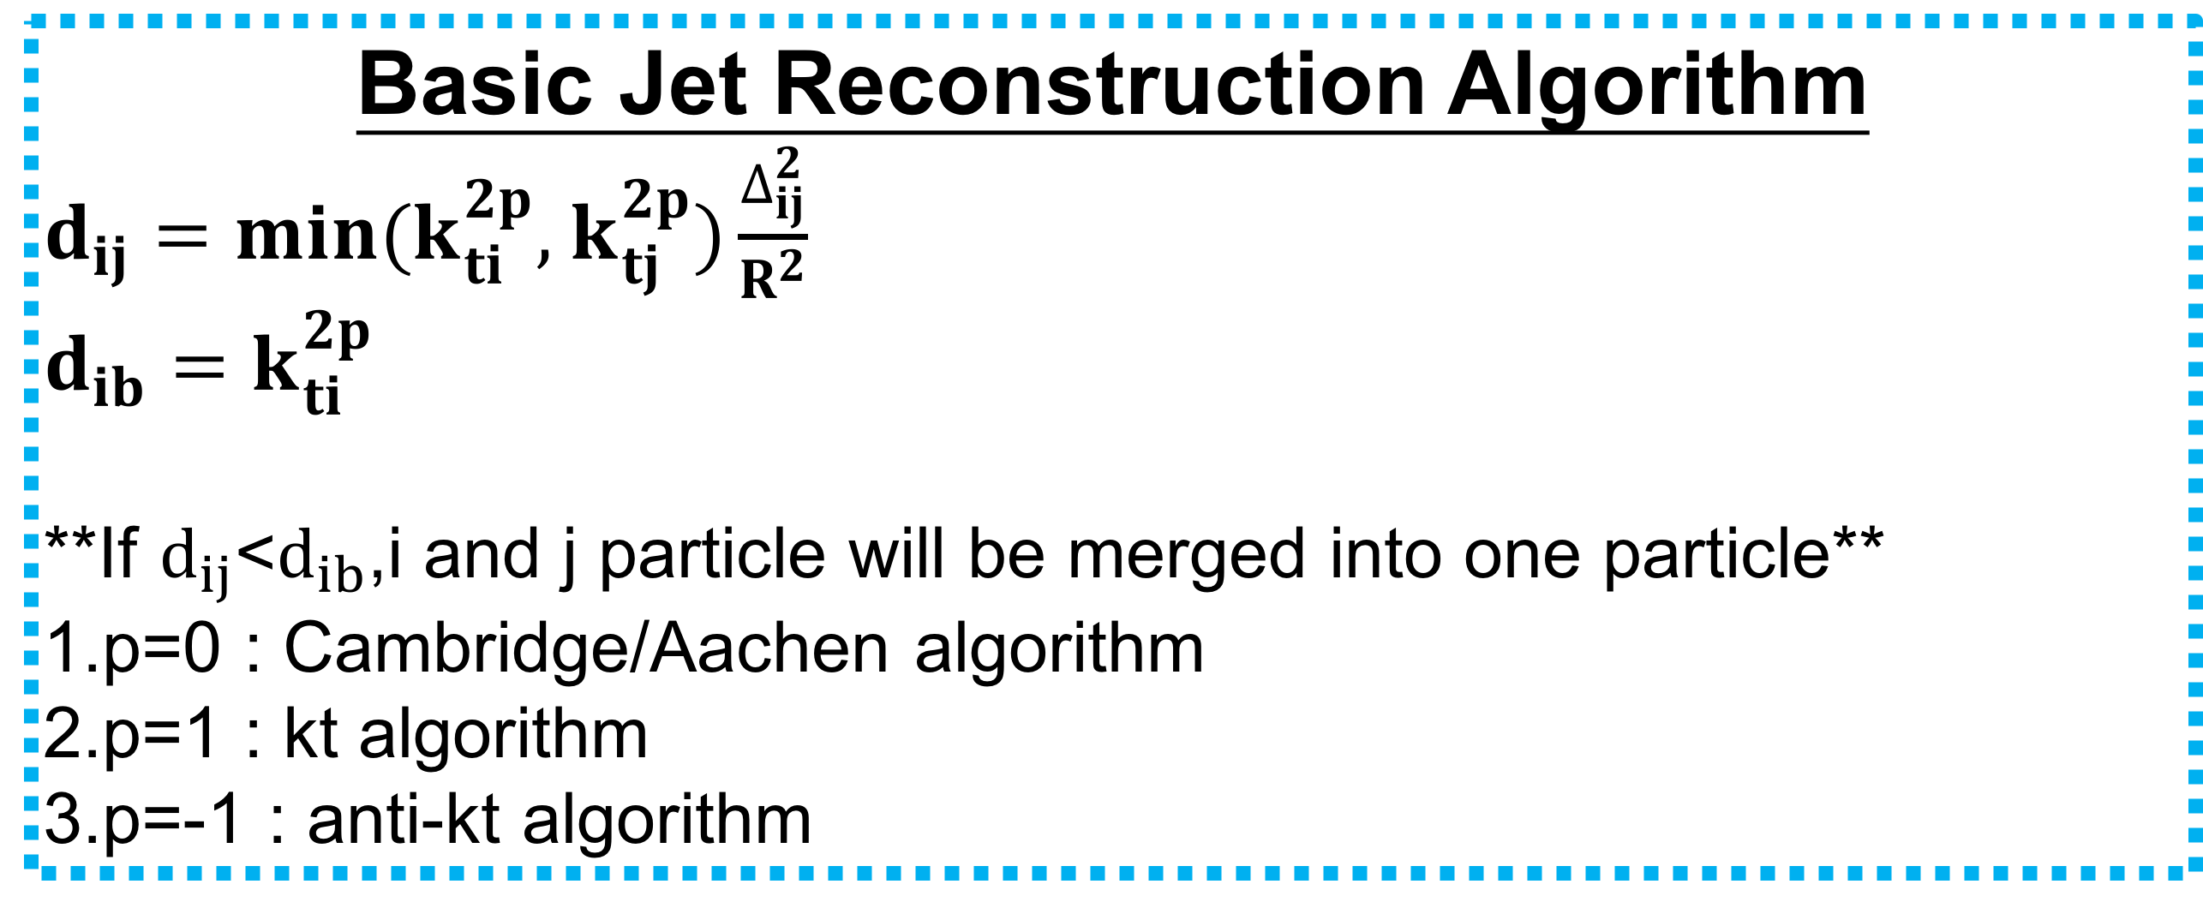

_{Ｄ}
Study of Jet Substructure Variables with the SiFCC Detector
at 100 TeV
*${\text{Chih}\text{−}\text{Hsiang} \text{Yeh}}^{1}$,${\text{Shin}\text{−}\text{Shan} \text{Eiko} \text{Yu}}^{1}$,${\text{Ashutosh} \text{Kotwal}}^{2,3}$, ${\text{Sergei} \text{Chekanov}}^{4}$,${\text{Nhan} \text{Viet} \text{Tran}}^{3}$
1.Department of Physics, National Central University, Chung-Li, Taoyuan City 32001, Taiwan
2.Department of Physics, Duke University, Durham, NC 27708, USA 3.Fermi National Accelerator Laboratory, Batavia, IL 6051, USA 4.HEP Division, Argonne National Laboratory, 9700 S. Cass Avenue, Argonne, IL 60439, USA
Abstract:
We study the performance of jet substructure variables with a detector designed for very high energy proton collisions, the SiFCC detector. The two-prong jets from Z'->WW and three-prong jets from Z'->ttbar are compared with the background from light quark jets at the same energy. The calorimeter geometry is benchmarked in various configurations in order to understand the impact of granularity on variables such as groomed jet mass, Njettiness and energy correlations within the jets. We present results on signal efficiency and background rejection using full GEANT simulations.
GEANT 4 Simulation of Future Detector
Results: Soft drop mass at $β=0$
HCAL cell sizes
5x5(cm)
From[1]
*Conclusion*
Basic Jet Reconstruction Algorithm
$d_{ij}=min(k_{ti}^{2p},$ $k_{tj}^{2p})\frac{∆_{ij}^{2}}{R^{2}}$
$$d_{ib}=k_{ti}^{2p}$$
**If $d_{ij}$<$d_{ib}$,i and j particle will be merged into one particle**
1.p=0 : Cambridge/Aachen algorithm
2.p=1 : kt algorithm
3.p=-1 : anti-kt algorithm
Is the smallest detector cell size always the best?
Basic Jet Reconstruction Algorithm
 | $$\sqrt{s}=5TeV$$ | $$\sqrt{s}=10TeV$$ | $$\sqrt{s}=20TeV$$ | $$\sqrt{s}=40TeV$$
Signal=WW | v | v | v | x
Signal=tt | x | v | v | x
$$∆_{ij}^{2}=({y_{i}−y_{j})}^{2}+{(∅_{i}−∅_{j})}^{2}$$
(1)$i,j$: the $i$ and $j$ particle
(2)$k_{ti},$ $k_{tj}$: the particle $i$ and $j$ transverse momenta
Results: C and Tau variables
$$C_{2}^{1}$$
$$τ_{21}$$
Jet Substructure Variables
Jet Substructure Variables
1.N-subjetness[2]:
$τ_{N}=\frac{1}{d_{0}}\sum_{k}{P_{t,k} min\{∆R_{1,k},∆R_{2,k}…∆R_{N,k}\}}$
${ d}_{0}=\sum_{k}{P_{t,k}R_{0}}$
$∆R_{i,k}:The distance between constuient in the eta−phi plane$
$R_{0}:The cone size we want to cluster$
$τ_{21}=\frac{τ_{2}}{τ_{1}},$ $τ_{32}=\frac{τ_{3}}{τ_{2}}$
2.Energy correlation function[3]:
$$ECF\left(N,β\right)=\sum_{i_{1}<i_{2}<..<i_{N}∈J}{(\prod_{a=1}^{N}{PT_{ia}){(\prod_{b=1}^{N−1}{\prod_{c=b+1}^{N}{∆R_{ibic}}})}^{β}}}$$
$C_{N}^{(β)}≡$ $\frac{ECF\left(N+1,β\right)ECF(N−1,β)}{{ECF(N,β)}^{2}}$
3.Soft drop[4]:
$$\frac{min(P_{T1,}P_{T2})}{P_{T1}+P_{T2}}<Z_{cut}{(\frac{∆R_{12}}{R_{0}})}^{β}$$
$$β>0:Remove both \left(soft )and (wide angle\right)$$
$$β=0:Depend on the cut to select the asymmetry$$
$$β<0:Remove both \left(soft\right)and (collinear)$$
5x5(cm)
*Conclusion*
Is the smallest detector cell size always the best?
Overall, the best separation power is observed in the 5x5 cm cell size
Reference
[1]Initial performance studies of a general-purpose detector for multi-TeV physics at a 100 TeV pp collider, JINST 12 (2017) P06009
[2]Identifyling Booseted Objects with N-subjettiness, JHEP03(2011)015
[3]Energy correlation Functions for Jet Substrcture, JHEP06(2013)108
[4]Soft drop, JHEP05(2014)146
[5]Recursive soft drop, arxiv:1804.03657
Signal and Background Process
Background:
Signal:

